Slide 1


Engaging patients in Digital Health
Dr Liz Mear
Chief Executive, Innovation Agency
@mearliz

Slide 2
Involvement in decisions about care
Patient-centred care
Personalised, individual choices/treatment/ prevention
Sensitivity to individual preferences
Notes:
The NHS England Five Year Forward View sets out a vision for a shift in power to patients and the public and puts a clear focus on prevention
“One of the great strengths of this country is that we have an NHS that – at its best – is ‘of the people, by the people and for the people…we need to engage with communities and citizens in new ways, involving them directly in decisions about the future of health and care services.”
NHS England has a legal duty under section 13Q of the National Health Service Act 2006 (as amended by the Health and Social Care Act 2012) to properly involve patients and the public in its commissioning processes and decisions
Radical upgrade in prevention and public health
Personalised, individual choices and treatment results in patients knowing what their choices are and not being surprised or unhappy by the result.

Slide 3
Involvement in design, planning and delivery of health services and solutions
Innovative Approaches
Co-production
Collaboration
Notes:
Shared Decision Making not only at the care level, but also at the strategic and commissioning level, with patients involved in the co-design, co-commissioning and co-production of healthcare.

Slide 4
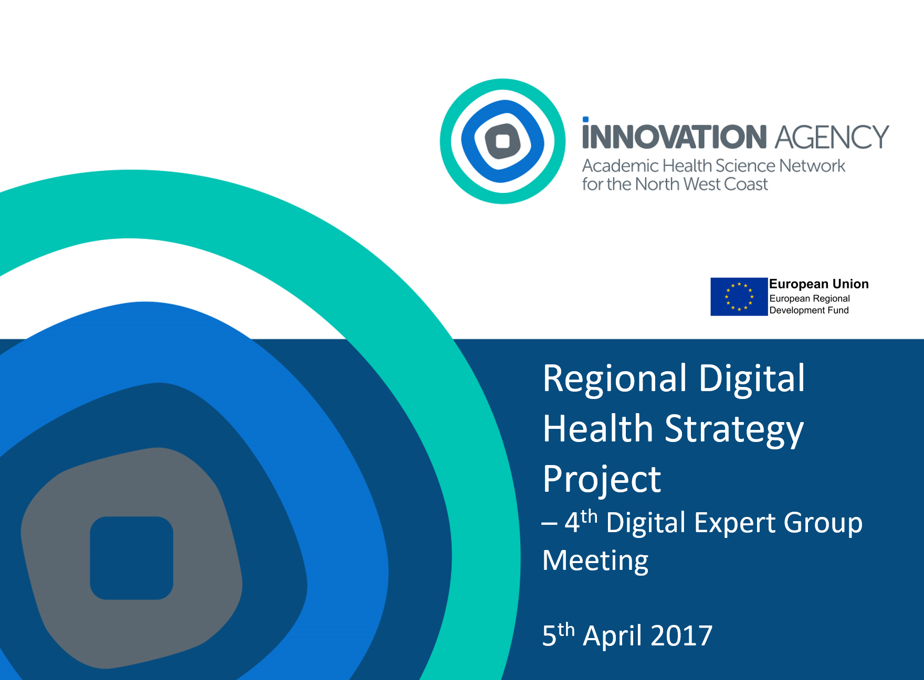
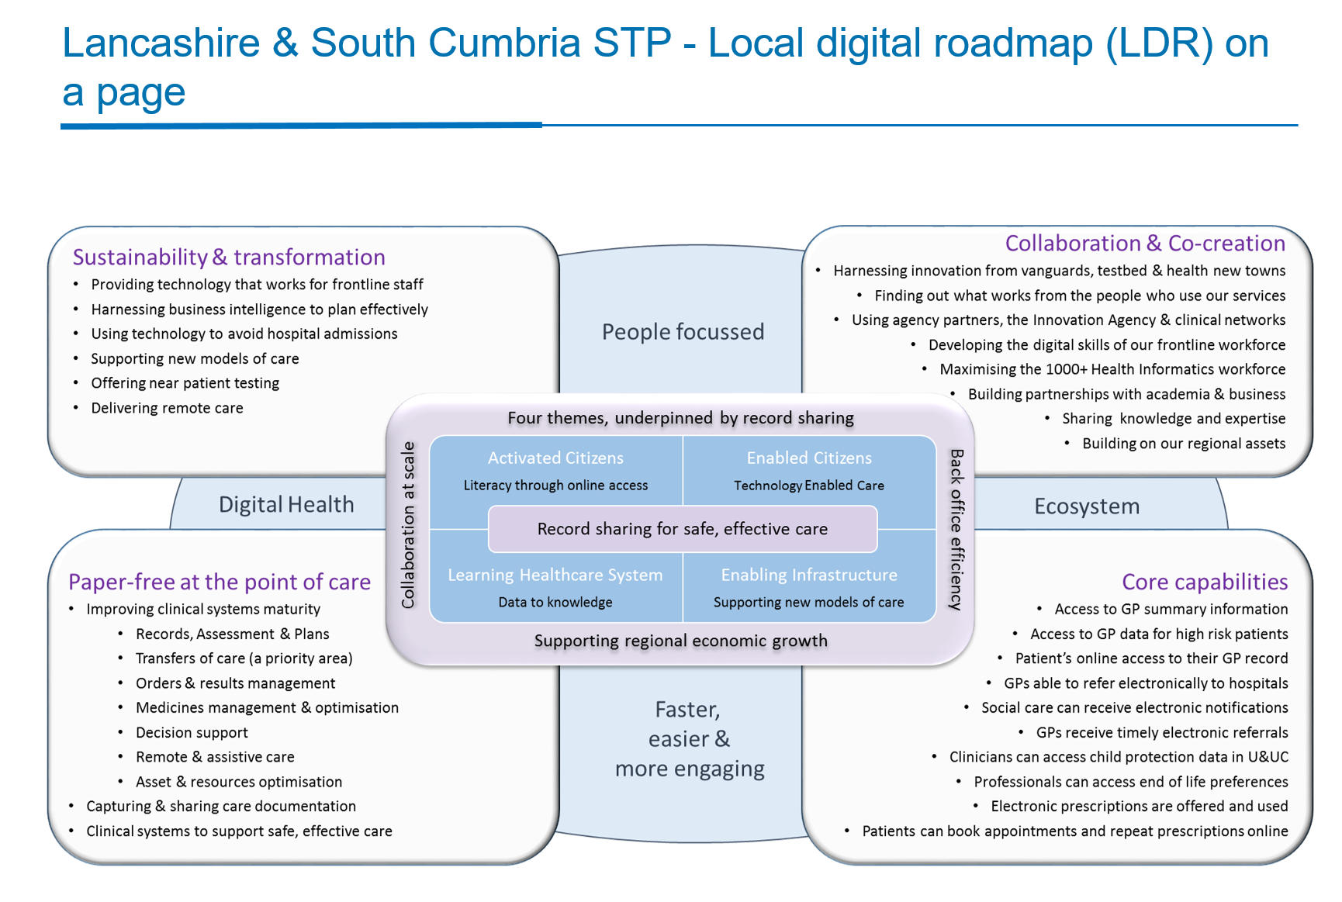
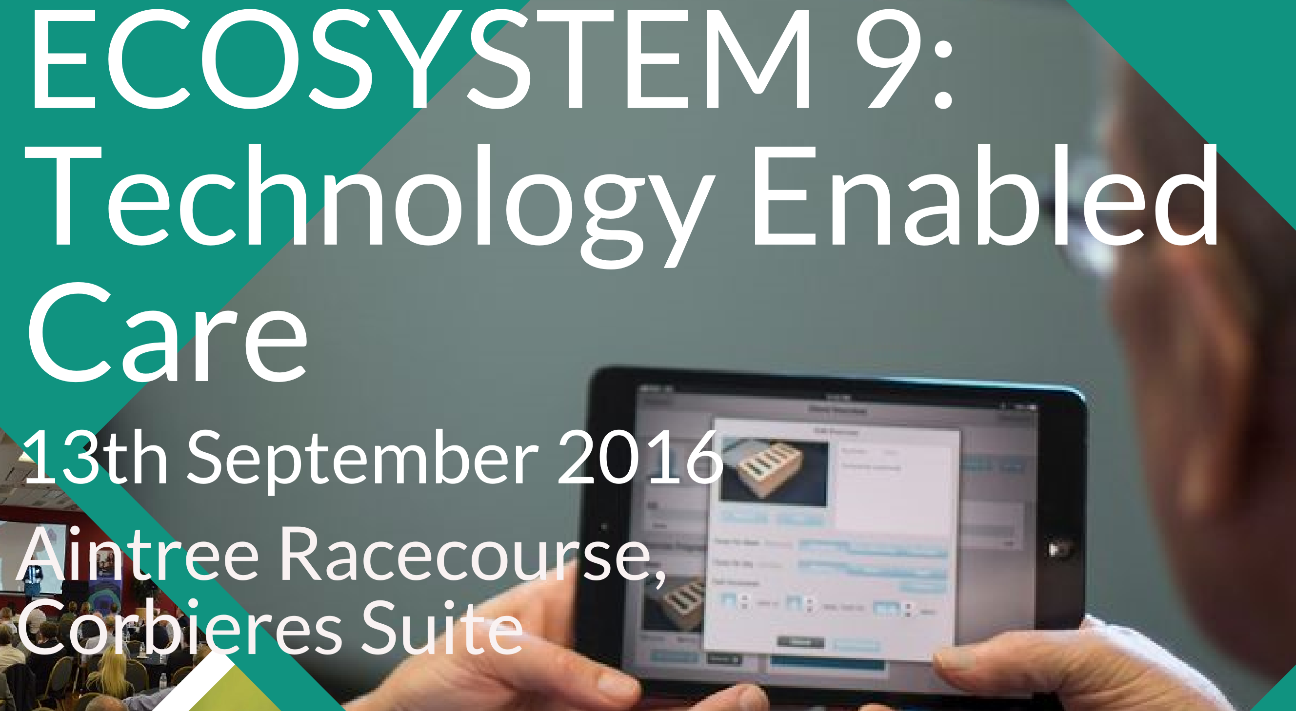
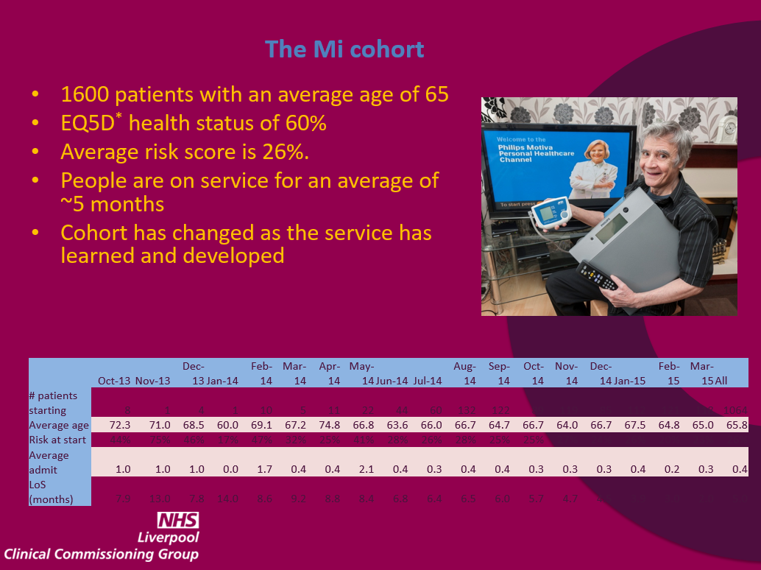
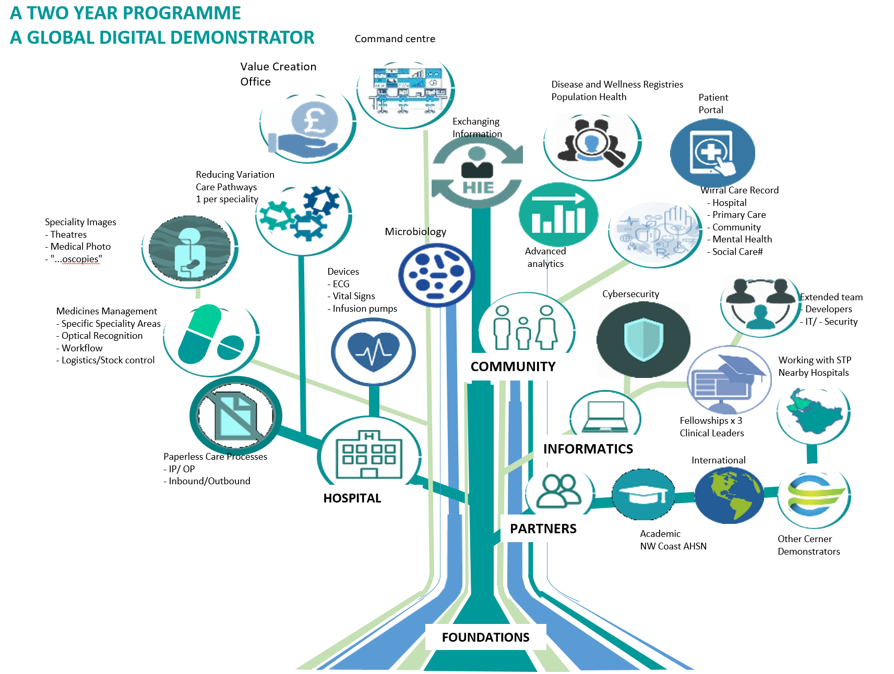
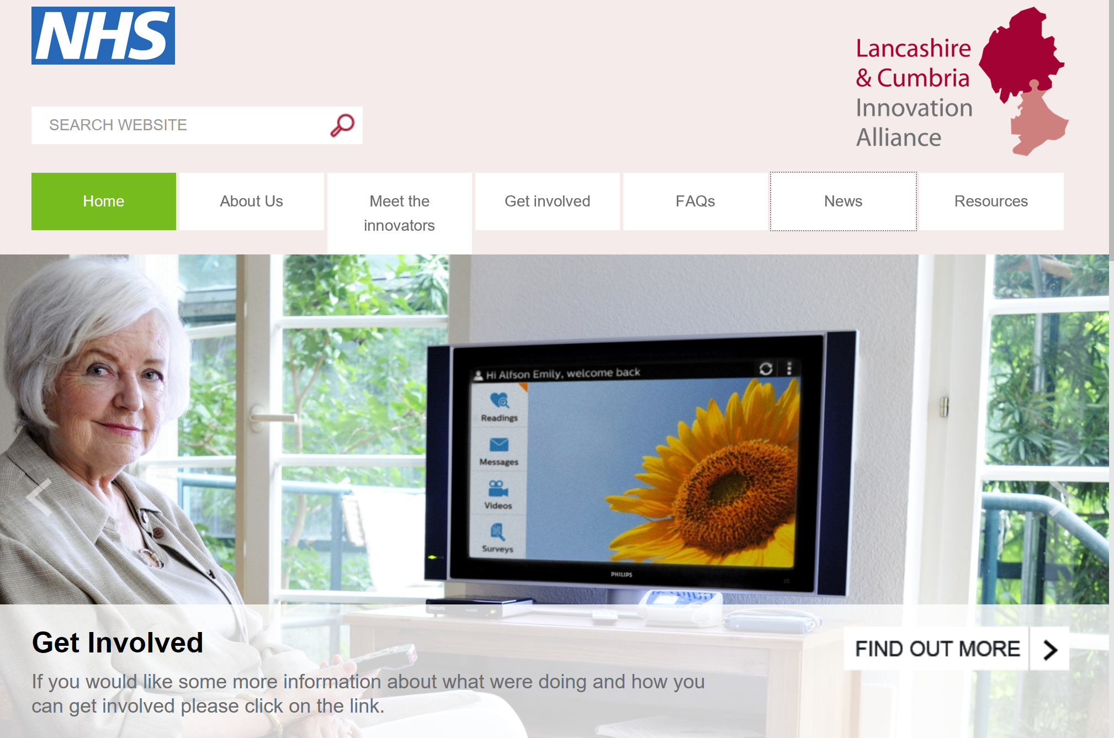
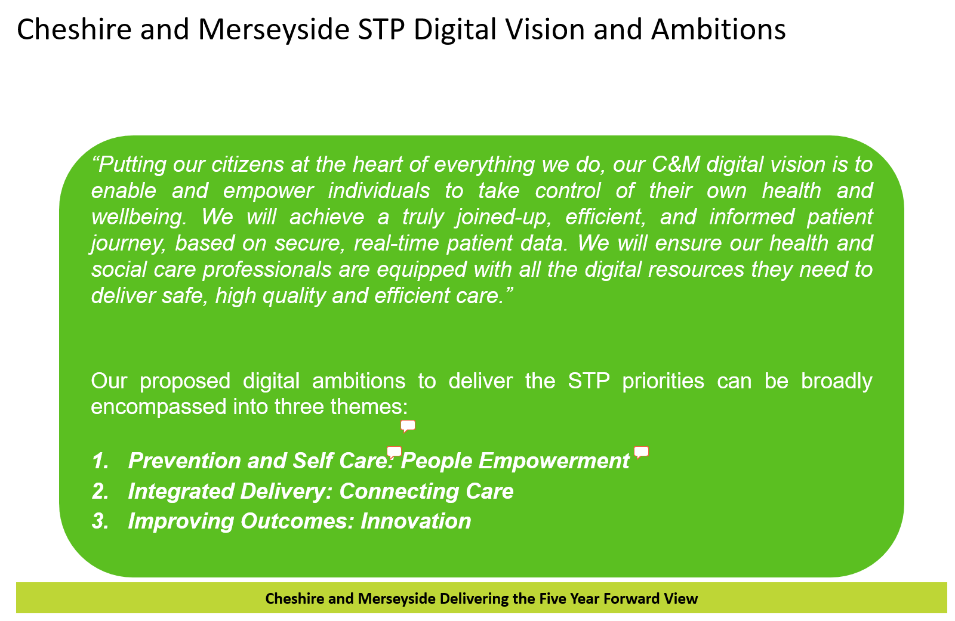
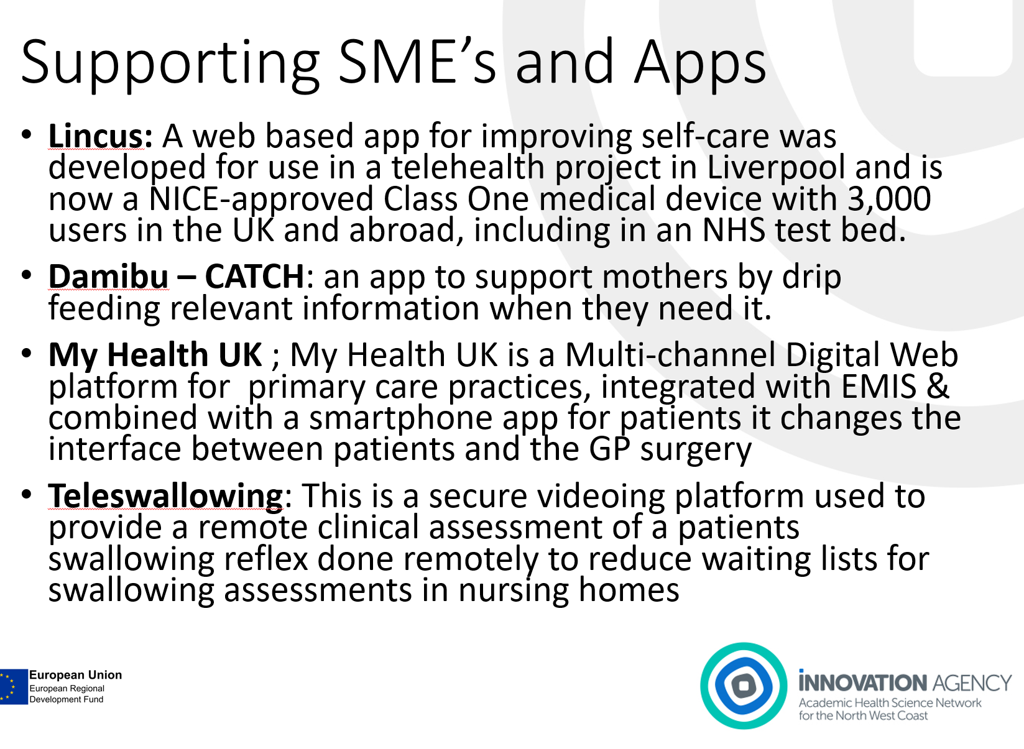
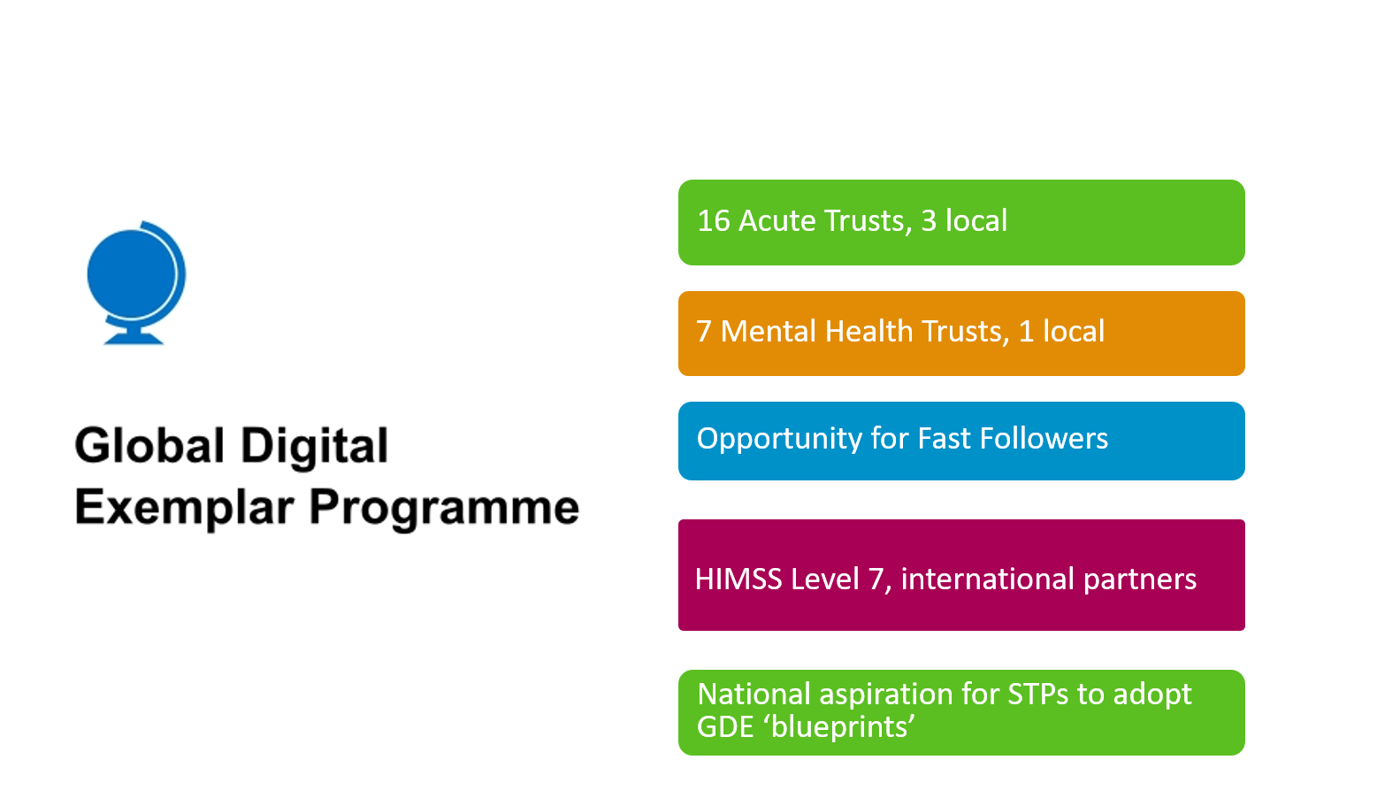

North West Coast – engaging patients…
Presentation 1
2

Slide 5
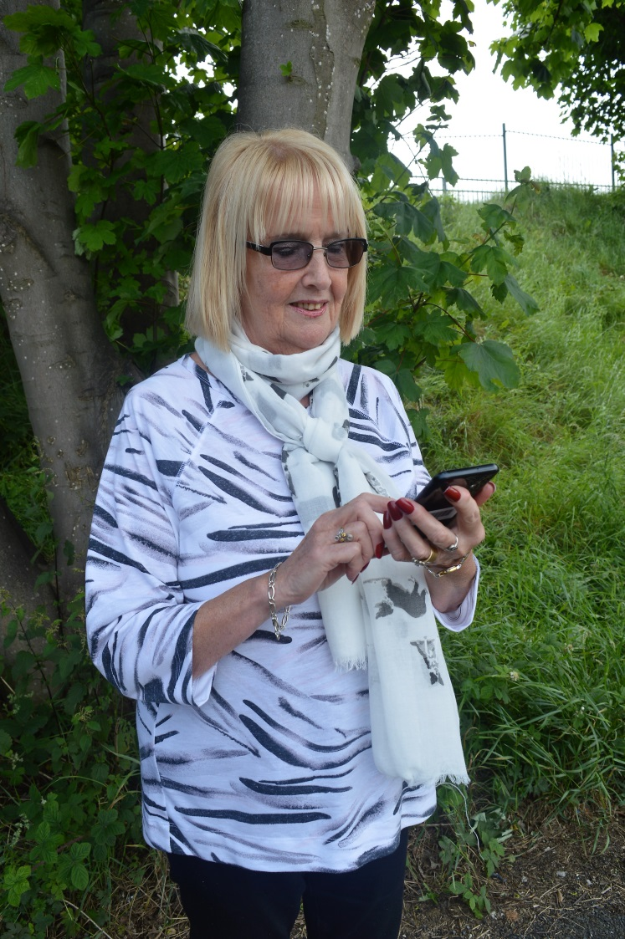
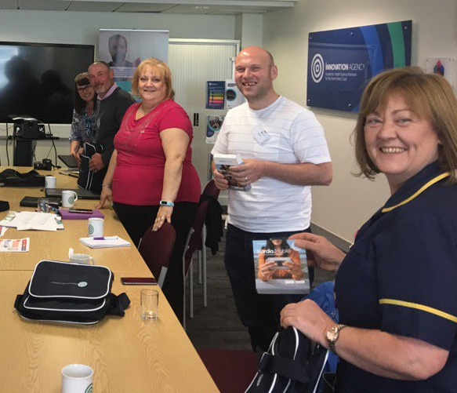

Innovation Agency Citizen engagement
Patient Involvement and Engagement Senate - supporting Connected Health Cities; testing tech; consulting re data sharing
Recruited COPD patients and residents to trial mobile apps
Launched AF Ambassadors
Spread use of ‘How are you today?’ COPD app
Supported CHC and 100,000 Genomes re patient consent on sharing data
Formed group of alcohol patients as patient reps
Notes:
Connected Health Cities project #datasaveslives
Selecting digital innovations for the region to adopt
Providing case studies of residents use of healthcare tech
European pilot of ENSAFE phone app project (Breathe Easy Groups and U3A involved)
Writing app wizard for consent to be used in ORCHA approved apps
U3A members involved in Get Active Trackers step challenge

Slide 6
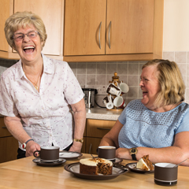
Telehealth at scale: Liverpool
95% of GP practices now referring
4650 patients have received service
801 patients live in the system
New flow monitoring pathways:
  Asthma, quit smoking, hypertension
Asthma kids gaming app development
Procurement under way
"It's so easy to use - nothing complicated, just peace of mind"

Slide 7
Telehealth at scale: Liverpool outcomes
Measurable and controlled (for people with r>25%)
  23% reduction in admissions
  20% reduction in cost (AE,OP,IP)
  18% reduction in visits (AE/OP)
Patient Reported Outcomes (all patients)
  91% of patients feel more in control, have gained confidence and/or feel better able to cope with their long-term conditions.
  54% of users reported a decrease in GP visits or community matron or hospital
  63% of users who report improved self-care also report reduced healthcare service use

Slide 8












Telehealth Test Bed in Lancashire
Test Bed is focused on how the use of innovative technology can support people aged 55 and over with long term conditions such as COPD,Diabetes and Dementia to remain well in the community
Innovators:
•Philips
•Speakset
•Cambridge Cognition
•uMotif
•Intelesant
•Florence
•Simple Telehealth
•Good Things Foundation
Clinical delivery:
•Fylde Coast Vanguard
•Better Care Together Vanguard
Evaluation:
•Lancaster University’s Centre for Aging Research (C4AR)
Governance:
•Lancashire Care NHS Foundation Trust
•Lancaster Health Hub
•Innovation Agency
Notes:
By keeping people well in the community, we will increase the quality of care provided and improve patient outcomes, create capacity within hospitals, and reduce overall costs by minimising wider health and social care usage.

Slide 9
Prevention - detecting
Atrial Fibrillation to reduce strokes

Slide 10
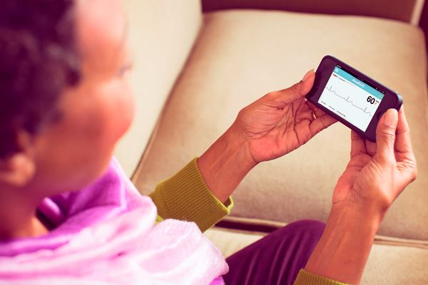
AliveCor portable ECG
“This device will not replace the ECG department, but it will make it quicker. The fact that the device worked first time, was easy to use and required no training meant that from the start it looked like a winner.”
Dr Chris Mimnagh, GP
Notes:
What is it?
A portable ECG monitor
How we helped
Run two public pulse check campaigns. Developed a NWC AF Collaboration group. Secured funding to improve the warfarin pathway. Supported the development of the AF pathway. Supported the development of a dashboard which brings together AF related databases to support CCGs with business planning. Secured £250 of matched investment from pharma and device partners.
Benefits
Our ongoing work to identify AF led to more than 10,000 screenings and more than 250 potential strokes being avoided, saving around £5.6m in NHS resources from 2014 to early 2017
Each stroke costs around £24,000 to the NHS and social care in the first year alone. AF is under diagnosed and undertreated – estimate 10,000 people have the condition, but 40 per cent may not be managed according to NICE guidelines

Slide 11
AF work programme since 2014
Detect
2 campaigns
Innovative technology mobile ECG
Protect
NWC AF Collaborative
Self-monitoring
Correct
Geno-type guided dosing
Dashboards
Work in a variety of settings
AF Ambassadors
Digitally integrated systems
Commissioners pathway APP

Slide 12
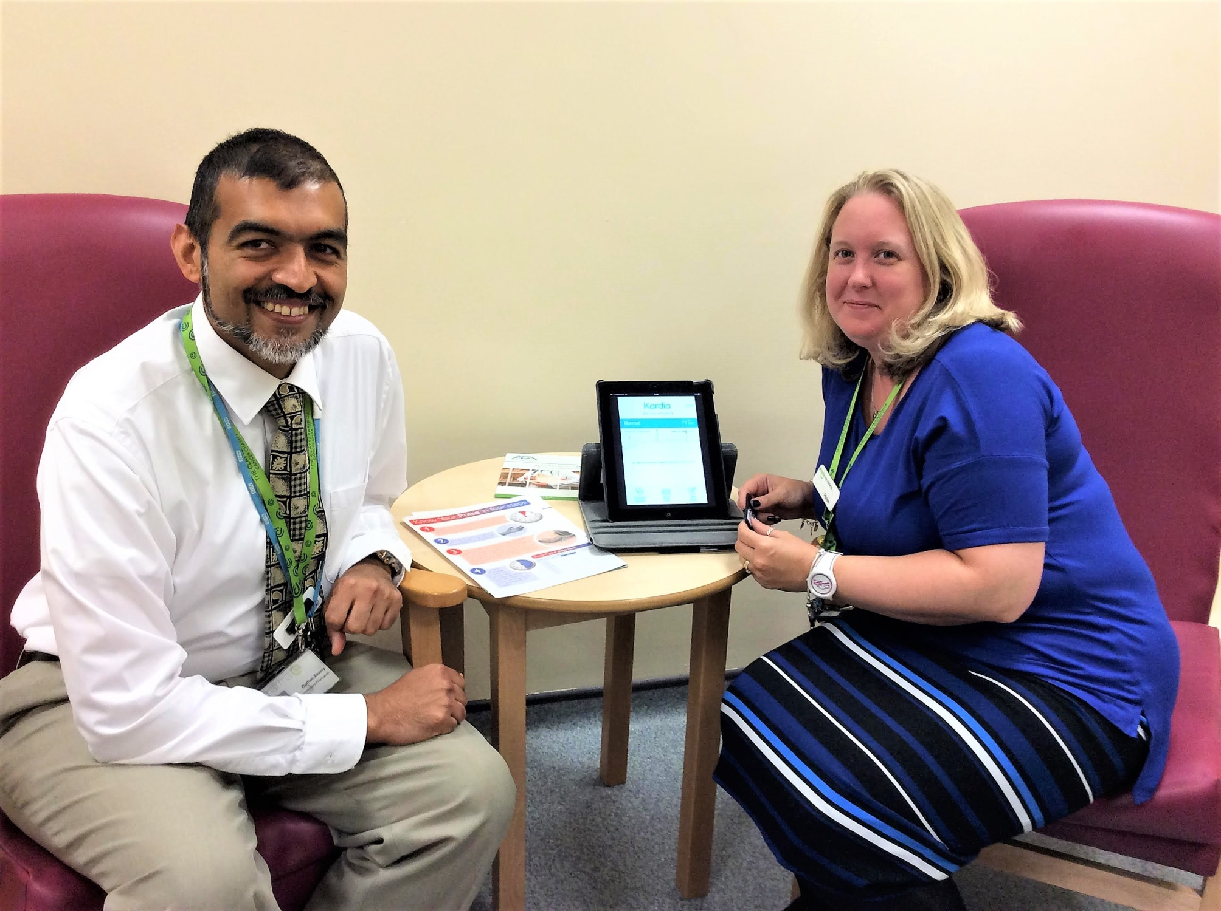
AF Ambassadors
Burhan Zavery, a pharmacist at Clatterbridge Cancer Centre NHS Foundation volunteered to become an AF Ambassador to help spot colleagues, friends and relatives at risk of a stroke.
In his first two months as an ambassador , Burhan has tested nearly 200 of his family, friends and colleagues, identifying six irregular heart rhythms

Slide 13
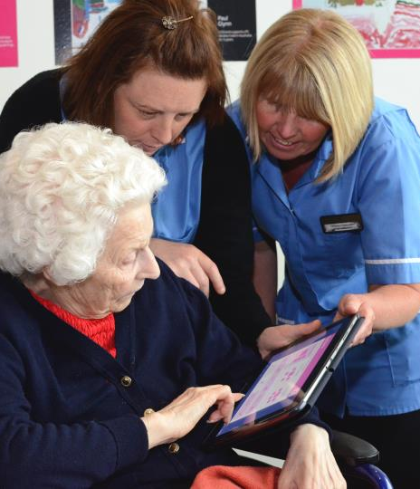
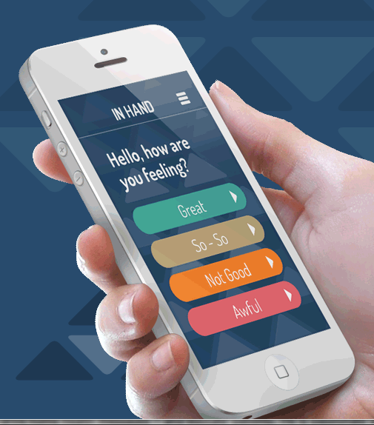


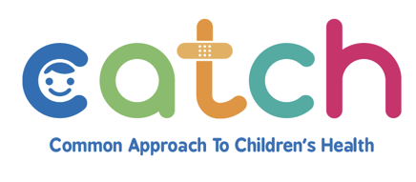
Digital health platforms – created in our region

Slide 14


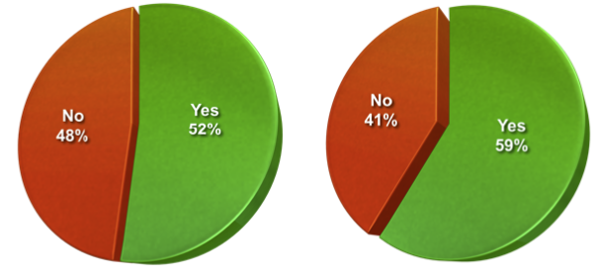
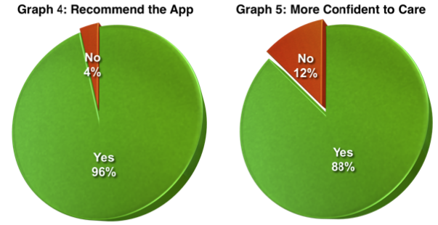
Winter A&E
2015->2016 15%
Over 2000 downloads in Cheshire East
Coming soon to Halton
Prevented A&E visit
Prevented GP visit
Recommend the app
More confident to
provide self-care

Slide 15
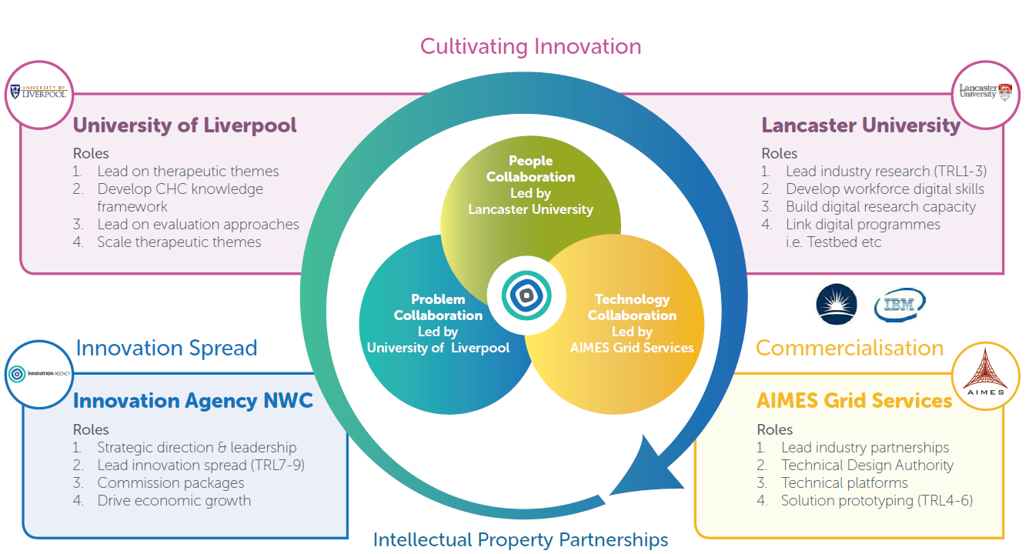
NWC Connected Health Cities partners
Notes:
What is it?
The detailed 3D printed anatomical models are created from patient scan data. They allow surgeons to perform surgical simulations on the models and test the size and placement of medical devices that may be needed.
How we helped
The Innovation Agency has supported an SME to deliver this innovative service in one hospital and has provided £25,000 funding to support 3D printing in two further hospitals.
Benefits
Improve surgical outcomes
Improve surgical planning, which shortens the time a patient is anaesthetised
Reduce the time that the surgical team is in theatre
Reduce patients’ time undergoing rehabilitation treatment
Improve surgical skills and training

Slide 16
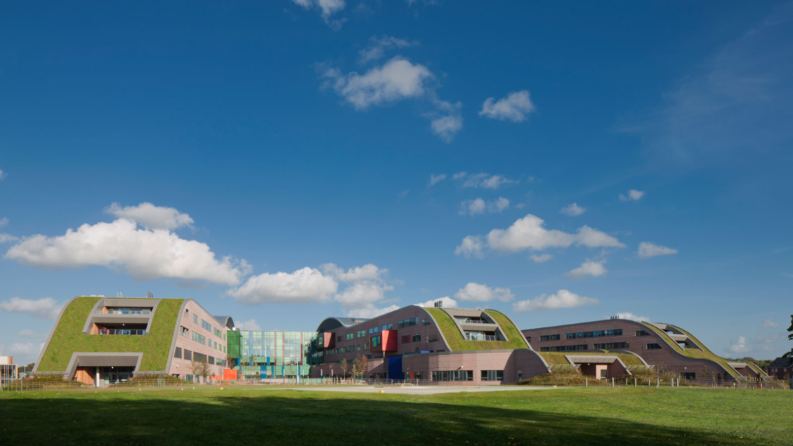


Slide 17
